Slide 1
VX425 Technology Entrepreneurship
Individual Exercise
Pan Chongdan

Slide 2
Venture Management and Leadership
1
What is Leadership
2
Relation to Entrepreneurship
3
Leadership Skills
4
Application in Telepresence Robot Project

Slide 3
What is Leadership?
Failure
Leadership
Excellence
The ability to influence through communication of the activities of others, individually, or as a group, toward the accomplishment of worthwhile, meaningful, and challenging goals.
Pursuit of excellence
No absolutes correct answers
Anyone can be a leader
Form from continuous learning

Slide 4
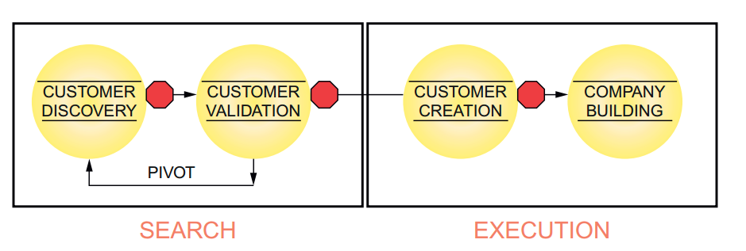
Relation to Entrepreneurship
Start-up Phase
Chaotic and full of ambiguity
Search business model
Ensure everyone’s productivity
Company phase
Build a capable company
Execute the business model
Make money

Slide 5
Relation to Entrepreneurship
Reasoning
Using facts and data to develop a logically sound argument
Influence Strategy
Essence of leadership behavior
Bargaining
Negotiating through the use of benefits or favors
Sanctions
Using rewards and punishment
Coalition
Mobilizing others in the organization

Slide 6
Relation to Entrepreneurship
Friendliness
Using supportiveness, praise, and the creation of goodwill
Influence Strategy
Essence of leadership behavior
Higher Authority
Gaining the support of higher levels in the hierarchy to add weight to the request
Assertiveness
Using a direct and forceful approach

Slide 7
Leadership Skills
Scholar Noel M. Tichy, “The ultimate test for a leader is not whether he or she makes smart decisions and takes decisive action, but whether he or she teaches others to be leaders and builds an organization that can sustain success even when he or she is not around.”
Skills
Influence
Leadership
An ability in performing a particular task
Learned and developed through practice

Slide 8
Leadership Skills
Analytic skills involve using repeatable approaches or techniques to solve organizational problems
Identify key factors affecting venture performance
Understand how multiple complex variables interact
Make complex variables interact at a desirable manner
Analyze one’s talents and associate them with the venture
Technology should be equal to Business!

Slide 9
Leadership Skills
Decision-making skills involve selecting actions which focus and guide the venture
Irresolvable ambiguity
Incomplete Information
Resist Pressure
Analyze the alternatives
Choose the best solution
Get the satisfying situation

Slide 10
Leadership Skills
Communication skills involve the ability to communicate in ways that other people understand, and to seek and use feedback from others to ensure that one is understood.
Fund Raising
Deliver a short and clear
elevator pitch to
potential investors
Business Plan
Boil an entire business
plan to short summary
for key stakeholders
Assign Tasks
Use clear technical
jargons to communicate
with subordinates

Slide 11
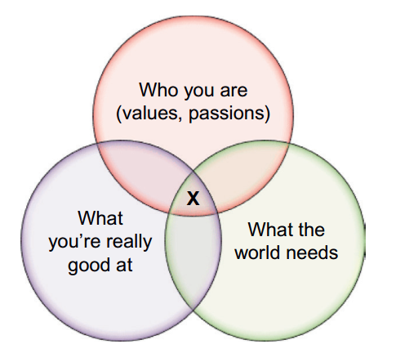


Leadership Skills
Conceptual skills consist of the ability to see the big picture, the complexities of the overall organization, and how the various parts fit together
Visionary - affect company’s future
Big, hairy, audacious goals (BHAG)
Apple - create insane great products
FedEx – packages had to absolutely, positively get there overnight.

Slide 12
Leadership Skills
Resilience skills
Team Building Skills
A Coherent Team
Manage start-up’s turbulence emotionally, financially, and physically
Maintain the equilibrium of venture
Control personal feelings
Identify gaps in talent and skills required for success
Attract employees, advisors or investors with required talent

Slide 13
Self-Awareness skills
Personality
Attitudes
Values
Leadership Skills
Ethics
Ethics
Integrity
Honesty (Transparency)
Humility
Self-Awareness skills require the leader to keep tracking his behavior and make improvement from three aspects.

Slide 14
Application in Our Project
A gold opportunity to gather experience and develop leadership skills
High requirement for leadership
Telepresence robot is an advanced technology entrepreneurship project.
Start-up phase
Undefined future market
No clear model or example
Few competitor

Slide 15
Application in Our Project
We’re engineers using telepresence robot to improve connection
The worlds need a way to realize remote physical connection
We’re good at making mechanic design and controlling electronic devices
Analytic skills – Reasoning
Analyze ourselves and existing product from data and find core requirements.
Decision-making skills - Assertiveness
Determine the business model and specific development directions
Concept skills – BHAG
Generate a vision: Connect people together mentally even though they’re far from each other physically.

Slide 16
Application in Our Project
Communication skills
Higher Authority
-Make business plan
Team-Building skills
Bargaining & Coalition
-Attract investors and talents
Resilience skills
Friendliness
-Provide support or praise for workers in trouble
-Coordinate engineers from different fields
-Cooperate with partners
-Cope with turbulence

Slide 17
Reference and Bibliography
Thomas N. Duening, Robert D. Hisrich, Michael A. Lechter. “Technology Entrepreneurship” Elsevier Inc, 2015, p.289-308
Vivian Pospisil. “Nurturing Leaders”. Industry Week, November 17, 1997, p. 35

